Slide 1
COUNT SORT

Slide 2
Sorting algorithm
Sorting algorithm is an algorithm that puts elements of a list in a certain order
The most-used orders are numerical order and alphabetical order.
The data is often taken to be in an array, which allows random access, rather than a list, which only allows sequential access.

Slide 3
Why do we need count sort?
How fast can we sort?
Selection Sort, Bubble Sort, Insertion Sort:
Heap Sort, Merge sort:
Quicksort:
What is common to all these sorts?
Make comparisons between input elements
a_{i} < a_{j} , a_{i} ≤ a_{j} , a_{i} = a_{j} , a_{i} ≥ a_{j} , or a_{i} > a_{j}
O(n²)
O(n log n)
O(n log n) - average

Slide 4
Can we do better?
Yes, using linear sorts
Linear sorting algorithms
Counting Sort
Radix Sort
Bucket sort
Linear sorts are NOT “comparison sorts”

Slide 5
ALGORITHM
Input data: 1, 4, 1, 2, 7, 5, 2
1) Take a count array to store the count of each unique object.
Index: 0 1 2 3 4 5 6 7 8 9
Count: 0 2 2 0 1 1 0 1 0 0
2) Modify the count array such that each element at each index stores the sum of previous counts.
Index: 0 1 2 3 4 5 6 7 8 9
Count: 0 2 4 4 5 6 6 7 7 7
The modified count array indicates the position of each object in the output sequence.
3) Output each object from the input sequence followed by decreasing its count by 1.
Process the input data: 1, 4, 1, 2, 7, 5, 2.
Position of 1 is 2. Put data 1 at index 2 in output.
Decrease count by 1 to place next data 1 at an index 1 smaller than this index.

Slide 6
Count-sort example
1
2
3
4
5
1
2
3
4
A:
4
1
3
4
3
C:
B:

Slide 7
Loop 1
1
2
3
4
5
1
2
3
4
A:
4
1
3
4
3
C:
0
0
0
0
B:

Slide 8
Loop 2
1
2
3
4
5
1
2
3
4
A:
4
1
3
4
3
C:
0
0
0
1
B:

Slide 9
Loop 2
1
2
3
4
5
1
2
3
4
A:
4
1
3
4
3
C:
1
0
0
1
B:

Slide 10
Loop 2
1
2
3
4
5
1
2
3
4
A:
4
1
3
4
3
C:
1
0
1
1
B:

Slide 11
Loop 2
1
2
3
4
5
1
2
3
4
A:
4
1
3
4
3
C:
1
0
1
2
B:

Slide 12
Loop 2
1
2
3
4
5
1
2
3
4
A:
4
1
3
4
3
C:
1
0
2
2
B:

Slide 13
Loop 3
1
2
3
4
5
1
2
3
4
A:
4
1
3
4
3
C:
1
0
2
2
B:
C':
1
1
2
2

Slide 14
Loop 3
1
2
3
4
5
1
2
3
4
A:
4
1
3
4
3
C:
1
0
2
2
B:
C':
1
1
3
2

Slide 15
Loop 3
1
2
3
4
5
1
2
3
4
A:
4
1
3
4
3
C:
1
0
2
2
B:
C':
1
1
3
5

Slide 16
Loop 4
1
2
3
4
5
1
2
3
4
A:
4
1
3
4
3
C:
1
1
3
5
B:
3
C':
1
1
2
5

Slide 17
Loop 4
1
2
3
4
5
1
2
3
4
A:
4
1
3
4
3
C:
1
1
2
5
B:
3
4
C':
1
1
2
4

Slide 18
Loop 4
1
2
3
4
5
1
2
3
4
A:
4
1
3
4
3
C:
1
1
2
4
B:
3
3
4
C':
1
1
1
4

Slide 19
Loop 4
1
2
3
4
5
1
2
3
4
A:
4
1
3
4
3
C:
1
1
1
4
B:
1
3
3
4
C':
0
1
1
4

Slide 20
Loop 4
1
2
3
4
5
1
2
3
4
A:
4
1
3
4
3
C:
0
1
1
4
B:
1
3
3
4
4
C':
0
1
1
3

Slide 21
PSUEDO CODE

Slide 22
Count sort (Running Time)

Slide 23
Time and Space complexities
TIME COMPLEXITY:
Best case Ω(n+k)
Worst case O(n+k)
Average case Ɵ (n+k)
SPACE COMPLEXITY:
O(k) auxiliary

Slide 24
Count sort is stable.
That is, repeating values appear in the output
array in the same order as they do in the input array.
A:
4
1
3
4
3
B:
1
3
3
4
4

Slide 25
Count sort is not inplace.
in-place algorithm is an algorithm which transforms input using no additional data structure.
The input is usually overwritten by the output as the algorithm executes.
Here we require two additional arrays in addition to the original array so count is not inplace.

Slide 26
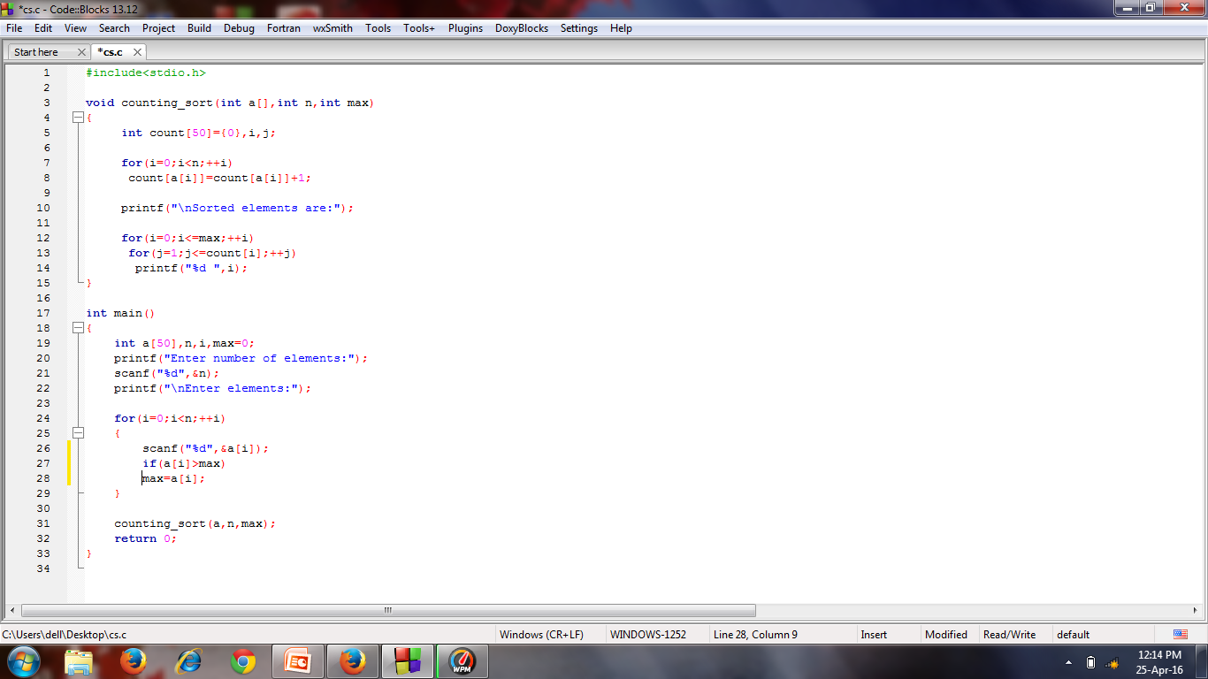

Slide 27
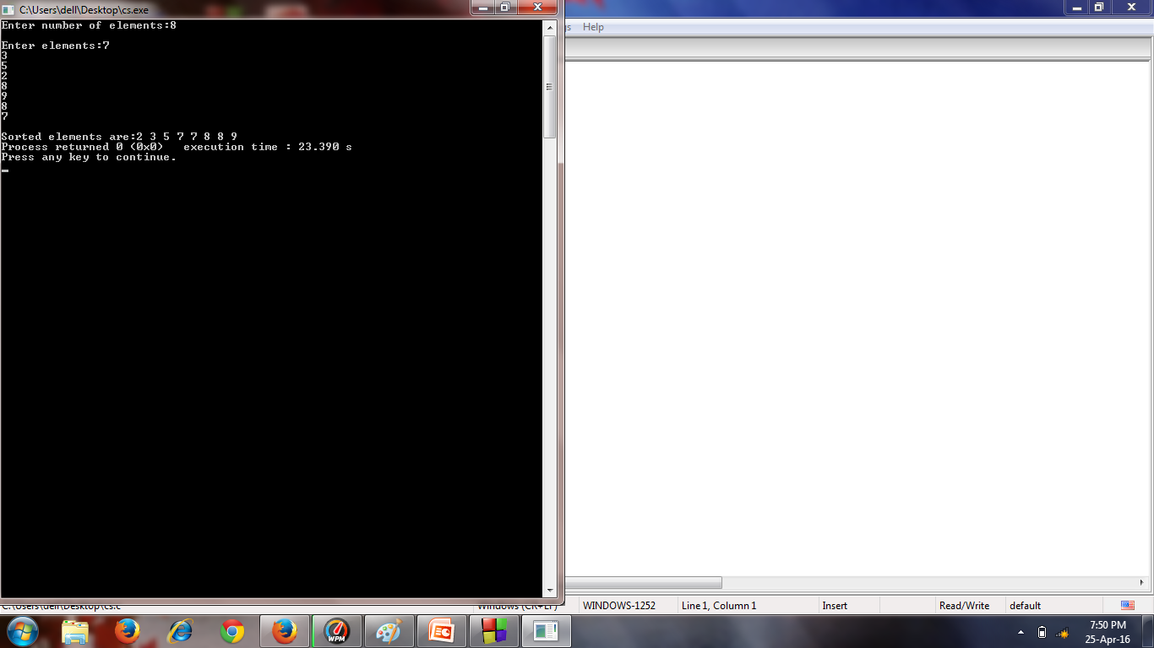

Slide 28
APPLICATIONS
It is used in implementing radix sort
Many technical applications use this kind of sorting:
Satellite payload(sort in benefit/weight ratio)
Processor scheduling(sort in priority)

Slide 29
Radix sort

Slide 30
Why radix sort??
The lower bound for Comparison based sorting algorithm (Merge Sort, Heap Sort, Quick-Sort .. etc) is Ω(nLogn), i.e., they cannot do better than nLogn.
Counting sort is a linear time sorting algorithm that sort in O(n+k) time when elements are in range from 1 to k.
What if the elements are in range from 1 to n²? We can’t use counting sort because counting sort will take O(n²) which is worse than comparison based sorting algorithms. Can we sort such an array in linear time?
Radix Sort is the answer. The idea of Radix Sort is to do digit by digit sort starting from least significant digit to most significant digit. Radix sort uses counting sort as a subroutine to sort.

Slide 31
What is a radix sort?
Radix Sort is an algorithm that sorts a list of numbers 1. Sorting takes place by distributing the list of number into a bucket by passing through the individual digits of a given number one-by-one beginning with the least significant part. Here, the number of buckets are a total of ten, which bare key values starting from 0 to 9.
2. After each pass, the numbers are collected from the buckets, keeping the numbers in order.
3. Now, recursively redistribute the numbers as in the above step '1' but with a following reconsideration: take into account next most significant part of the number, which is then followed by above step '2'.

Slide 32
ALGORITHM
Do following for each digit i where i varies from least significant digit to the most significant d
a) Sort input array using counting sort (or any stable sort) according to the i’th digit.
Example: Original, unsorted list: 170, 45, 75, 90, 802, 24, 2, 66
Sorting by least significant digit (1s place) gives: [*Notice that we keep 802 before 2, because 802 occurred before 2 in the original list, and similarly for pairs 170 & 90 and 45 & 75.]
170, 90, 802, 2, 24, 45, 75, 66
Sorting by next digit (10s place) gives: [*Notice that 802 again comes before 2 as 802 comes before 2 in the previous list.]
802, 2, 24, 45, 66, 170, 75, 90
Sorting by most significant digit (100s place) gives:
2, 24, 45, 66, 75, 90, 170, 802

Slide 33
Pseudocode
void radixsort(int arr[], int n)
Input- integer array arr[] of size n
a)int m = getMax(arr, n);
b)for (int exp = 1; m / exp > 0; exp *= 10)
countSort(arr, n, exp);
end for

Slide 34
int getMax(int arr[], int n)
Input: arr[]-integer array of size n
Ouput :maximum element f array
A)int max = arr[0];
B)for (int i = 1; i < n; i++)
if (arr[i] > max)
-max = arr[i];
end if
return max;
end for

Slide 35
void countSort(int arr[], int n, int exp)
Input: arr[]-integer array of maximum size n
exp-significant digit
a)int output[n];
b)int count[10] = {0};
c)for (i = 0; i < n; i++)
count[(arr[i] / exp) % 10]++;
end for
d)for (i = 1; i < 10; i++)
count[i] += count[i - 1];
end for

Slide 36
e)for (i = n - 1; i >= 0; i--)
-output[count[(arr[i] / exp) % 10] - 1] = arr[i];
-count[(arr[i] / exp) % 10]--;
end
f)for (i = 0; i < n; i++)
arr[i] = output[i];
end for

Slide 37
Example
Original, unsorted list:
170, 45, 75, 90, 802, 2, 24, 66
Sorting by least significant digit (1s place) gives:
170, 90, 802, 2, 24, 45, 75, 66
Sorting by next digit (10s place) gives:
802, 2, 24, 45, 66, 170, 75, 90
Sorting by most significant digit (100s place) gives:
2, 24, 45, 66, 75, 90, 170, 802

Slide 38
Time complexity
Best case time complexity-Ω(nk)
Average case time complexity-Ɵ(nk)
Worst case time complexity-O(nk)
Space complexity
Worst case space complexity-O(n+k)
where n is the number of keys, and k is the average key length.

Slide 39
Is radix sort inplace?
It is not inplace as it requires an extra space and
sorting is not done in the same array.

Slide 40
Is radix sort stable?
A Least significant digit (LSD) radix sort is a stable sorting algorithm which can be used to sort keys in integer representation order.

Slide 41
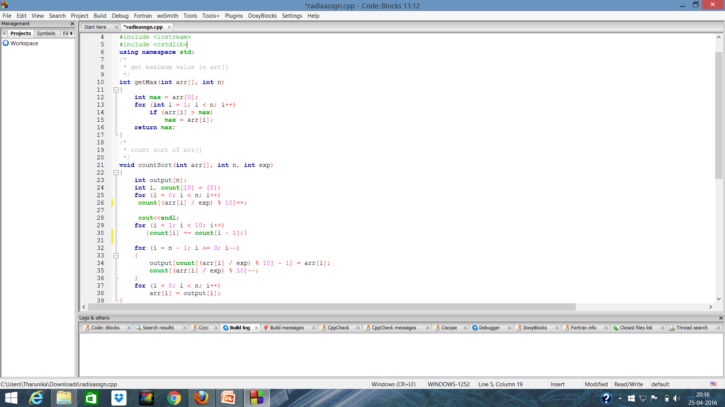

Slide 42
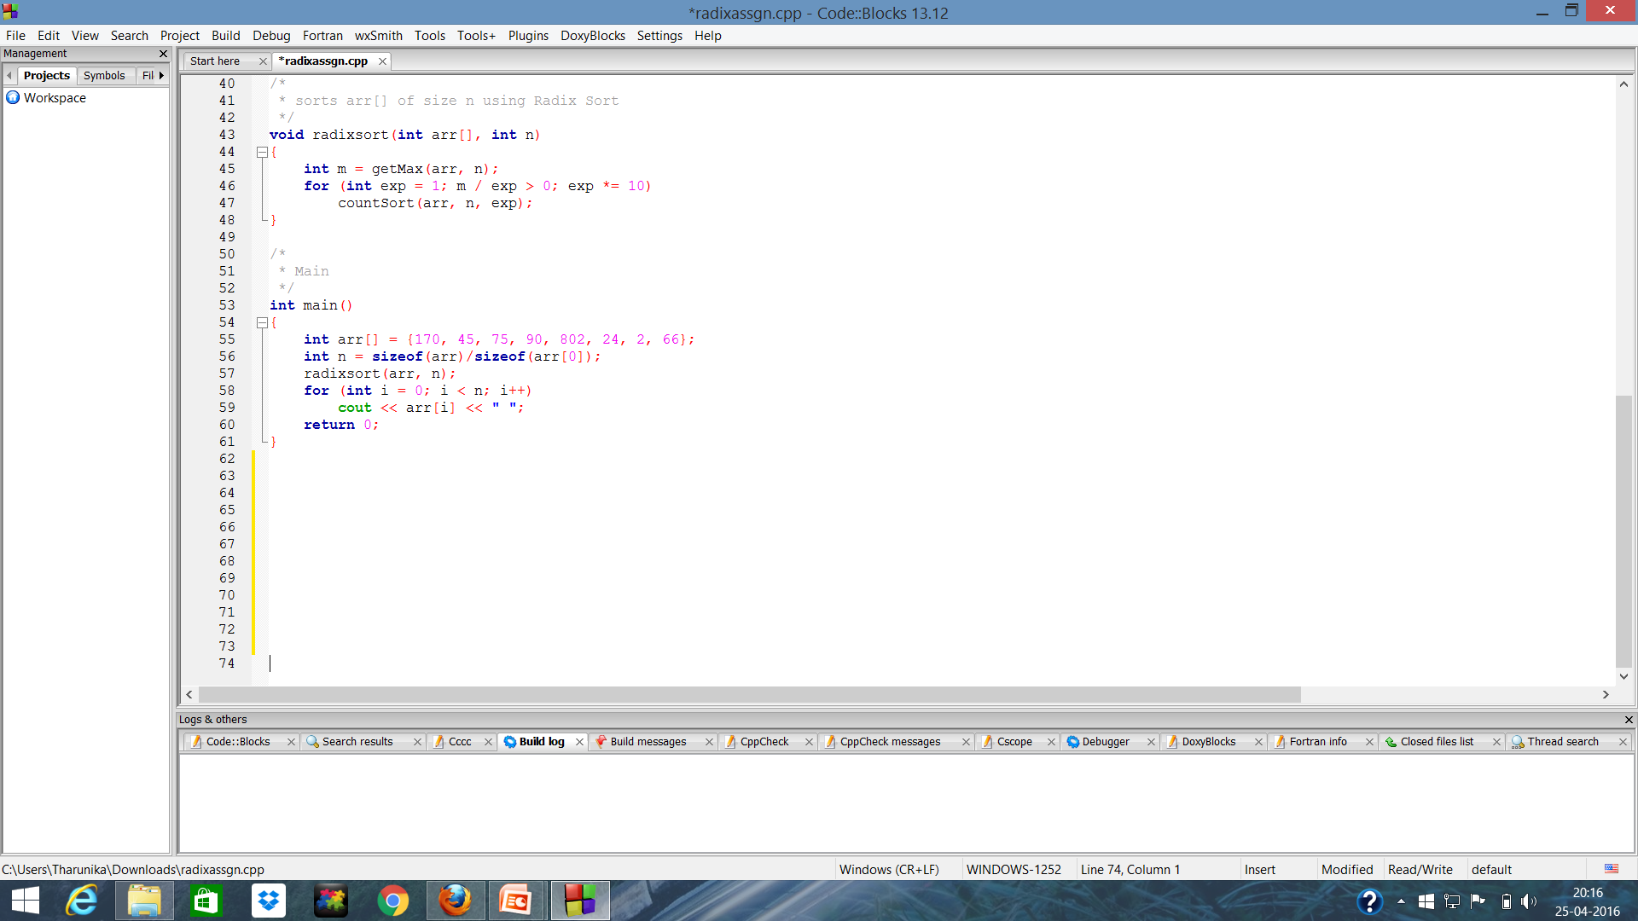

Slide 43
Disadvantages
1)Radix Sort can take up more space than other sorting algorithms, since we need a sublist for each of the possible digits or letters. For English words, you will need at least 26 different sublists, and if you are sorting alphanumeric words or sentences, you will probably need more sublists.
2)Since Radix Sort depends on the digits or letters, Radix Sort is also much less flexible than other sorts. For every different type of data, Radix Sort needs to be rewritten, and if the sorting order changes, the sort needs to be rewritten again. and it is very difficult to write a general purpose Radix Sort that can handle all kinds of data

Slide 44
Thank you

